Slide 1



chapter 19
groupware

Slide 2
Groupware
What is groupware
Types of groupware
  computer-mediated communication
  meeting and decisions support systems
  shared applications and artefacts
Models of groupware
Implementation issues

Slide 3
What is groupware?
Software specifically designed
  to support group working
  with cooperative requirements in mind
NOT just tools for communication
Groupware can be classified by
  when and where the participants are working
  the function it performs for cooperative work
Specific and difficult problems with groupware implementation

Slide 4
The Time/Space Matrix
Classify groupware by:
  when the participants are working,
  at the same time or not
  where the participants are working,
  at the same place or not
Common names for axes:
time:
synchronous/asynchronous
place:
co-located/remote
same
place
different
place
same
time
different
time

Slide 5
Time/Space Matrix (ctd)
same
place
different
place
same
time
face-to-face
conversation
telephone
different
time
post-it note
letter

Slide 6
Classification by Function
Cooperative work involves:
  Participants who are working
  Artefacts upon which they work
understanding
P
direct
P
participants
communication
control and
feedback
A
artefacts of work

Slide 7
What interactions does a tool support?
meeting and decision
support systems
  common understanding
computer-mediated communication
  direct communication between participants
meeting and decision support systems
  common understanding
shared applications and artefacts
  control and feedback with shared work objects
understanding
P
direct
P
computer-mediated
communication
  direct communication
  between participants
participants
communication
control and
feedback
A
artefacts of work
shared applications
and artefacts
  control and feedback
  with shared work objects

Slide 8
computer-mediated communication
email and bulletin boards
structured message systems
text messaging
video, virtual environments

Slide 9
Email and bulletin boards
asynchronous/remote
familiar and most successful groupware
Recipients of email:
direct in To: field
copies in Cc: field
delivery identical – difference is social purpose

Slide 10
Email vs. bulletin boards
fan out
  one-to-one – email, direct communication
  one-to-many – email, distribution lists
  BBs, broadcast distribution
control
  sender – email, private distribution list
  administrator – email, shared distribution list
  recipient – BBs, subscription to topics

Slide 11
Structured message systems
asynchronous/remote
`super' email
– cross between email and a database
sender
– fills in special fields
recipient
– filters and sorts incoming mail
based on field contents
… but – work by the sender
– benefit for the recipient

Slide 12
Structured message systems (ctd)
Type: Seminar announcement
To: all
From: Alan Dix
Subject: departmental seminar
Time: 2:15 Wednesday
Place: D014
Speaker: W.T. Pooh
Title: The Honey Pot
Text: Recent research on socially constructed meaning has focused on the image of the Honey Pot and its dialectic interpretation within an encultured hermeneutic. This talk …
N.B. global structuring by designer
vs. local structuring by participants

Slide 13

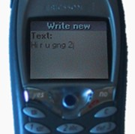
txt is gr8
instant messaging
  1996 – ICQ small Israeli company
  now millions
  more like conversation
SMS
  y is it we al lv shrt msgs
  originally a feature of internal management protocol
  short messages (160 chars) and text with numbers
  no-one predicted mass adoption!!
  now phones with cameras for MMS
Hi, u there
yeh, had a good night last night?
uhu
want to meet later

Slide 14

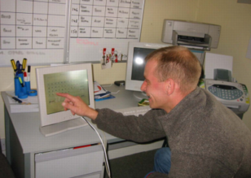
SMS in action
serious uses too … the ‘SPAM’ system
two hostels for ex-psychiatric patients
staff send SMS to
central number
messages appear in
both offices
avoids using phone
‘mission critical’ …
but used for jokes too!

Slide 15
Video conferences and communication
synchronous/remote
Technology:
  ISDN + video compression
  internet, web cams
major uses:
  video conferences
  pervasive video for social contact
  integration with other applications
often cheaper than face-to-face meetings
  (telecommunications costs vs. air flights)

Slide 16
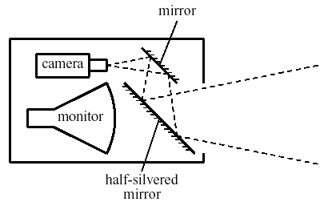
Video issues …
not a substitute for face-to-face meetings
  small field of view
  lack of reciprocity
  poor eye contact
One solution for lack of eye contact
… the video-tunnel

Slide 17

web-video
video-conferencing – expensive technology
but internet (almost) free!
web-cams
  used for face-to-face chat
  for video-conferencing
  for permanent web-cams
low bandwidth
  pictures ‘block out’ … not terrible
  audio more problematic
  may use text chat

Slide 18


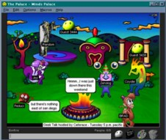
collaborative virtual environments (CVEs)
meet others in a virtual world
  participants represented – embodiment
  artefacts too …
    computer (e.g. spreadsheet) and ‘real’ (virtually) objects
  text?
    consistent orientation or easy to read
MUDs (Multi-user domains)
  2D/3D places to meet on the web
  users represented as avatars

Slide 19
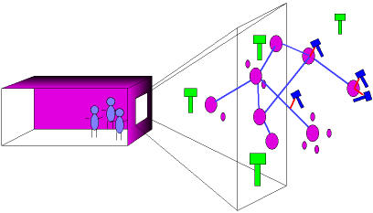
internet foyer
real foyer
  large screen, camera
  see virtual world on screen
virtual world
  representation of web
  see real foyer on virtual screen

Slide 20
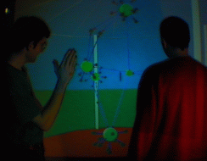
‘outside’ looking in

Slide 21
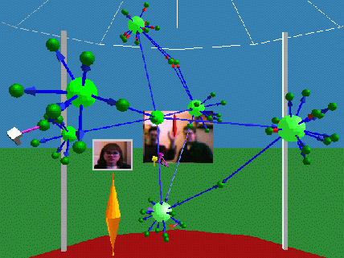
‘inside’ looking out

Slide 22
meeting and decision support systems
argumentation tools
meeting rooms
shared work surfaces

Slide 23
Meeting and decision support
In design, management and research,
we want to:
  generate ideas
  develop ideas
  record ideas
primary emphasis
– common understanding

Slide 24
Three types of system
argumentation tools
  asynchronous co-located
  recording the arguments for design decisions
meeting rooms
  synchronous co-located
  electronic support for face-to-face meetings
shared drawing surfaces
  synchronous remote
  shared drawing board at a distance

Slide 25
argumentation tools
asynchronous co-located
hypertext like tools to record design rationale
Two purposes:
  remining the designers of the reasons for decisons
  communicating rationale between design teams
Mode of collaboration:
  very long term
  sometimes synchronous use also

Slide 26
gIBIS
graphical version of IBIS
– issue based information system
various node types including:
  issues e.g. ‘number of mouse buttons’
  positions e.g. ‘only one button’
  arguments e.g. ‘easy for novice’
linked by relationships such as:
  argument supports position
  e.g., ‘easy for novice’ supports ‘only one button’

Slide 27
Meeting rooms
synchronous co-located
electronic support for face-to-face meetings
  individual terminals (often recessed)
  large shared screen (electronic whiteboard)
  special software
  U or C shaped seating around screen
Various modes:
  brainstorming, private use, WYSIWIS
WYSIWIS – ‘what you see is what I see’
  all screens show same image
  any participant can write/draw to screen

Slide 28




Typical meeting room
shared
screen

Slide 29
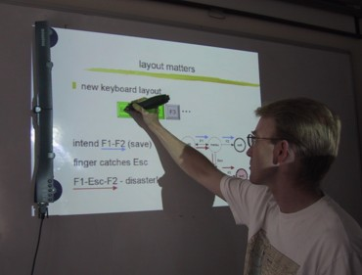
meeting capture
use ordinary
whiteboard
detector and
special pens
LCD projection
on whiteboard
low-cost alternative
to dedicated meeting room

Slide 30
Issues for cooperation
Argumentation tools
  concurrency control
    two people access the same node
    one solution is node locking
  notification mechanisms
    knowing about others' changes
Meeting rooms
  floor holders one or many?
    floor control policies
  who can write and when?
    solution: locking + social protocol
  group pointer
    for deictic reference (this and that)

Slide 31
Shared work surfaces
synchronous remote
At simplest, meeting rooms at a distance, but …
  additional audio/video for social protocols and discussion
  network delays can be major problem
Additional special effects:
  participants write onto large video screen
  problems with parallax
    shadow of other participant's hands appears on screen
  electronic image integrated with video and paper images
Example: TeamWorkStation
  remote teaching of Japanese calligraphy
  student's strokes on paper overlaid with video of instructor's strokes

Slide 32
shared applications and artefacts
shared PCs and windows
shared editors, co-authoring tools
shared diaries
communication through the artefact

Slide 33
Shared Applications and Artefacts
Compare purpose of cooperation:
  meeting rooms and decison support systems
  – develop shared understanding
  shared applications and artefacts
  – work on the same objects
technology similar but primary purpose different
many different modalities (time/space matrix)
  shared windows – synchronous remote/co-located
  shared editors – synchronous remote/co-located
  co-authoring systems – largely asynchronous
  shared diaries – largely asynchronous remote
  shared information – any, but largely asynchronous
synchronous remote needs additional audio/video channel

Slide 34
Similar … but different
Shared PCs and shared window systems
  Multiplex keyboard and screen
  Individual applications not collaboration aware
  Floor control problems:
    user A types: `interleave the'
    user B types: `keystrokes'
    result: `inkeytersltreaokeve tshe'
Shared editors
  An editor which is collaboration aware
  One document – several users
  Similar to shared screen in meeting room …
  … with similar floor control problems!
  Additional problem – multiple views

Slide 35
Shared editors - multiple views
Options:
  same view or different view
  single or separate insertion points
Single view
⇒ scroll wars
Multiple views
⇒ loss of context with indexicals

Slide 36
loss of WYSIWIS …
We will look at some of the
options and how they affect
the style of cooperation.
Thinking about the shared
view vs. different view
options, it at first seems
obvious that we should allow
people to edit different
parts of a document.
This is certainly true while
they are working effectively
independently.
More adaptable systems are
needed to allow for the wide
variation between groups,
and within the same group
over time.
We will look at some of the
options and how they affect
the style of cooperation.
Thinking about the shared
view vs. different view
options, it at first seems
obvious that we should allow
your screen
your colleague’s screen
  ‘I don’t like the line at the top’
  ‘but I just wrote that!’

Slide 37
Co-authoring systems
Emphasis is on long term document production, not editing
Two levels of representation
  the document itself
  annotation and discussion
Often some form of hypertext structure used
Similar problems of concurrency control to argumentation systems
Sometimes include rôles:
  author, commentator, reader, …
  but who decides the rôles?
  and how flexible are they?

Slide 38
Shared diaries
Idea:
  make diaries and calendars more easily shared
  allow automatic meeting scheduling etc.
Issues for cooperation:
  privacy – who can see my diary entries?
  control – who can write in my diary?
Similar to file sharing issues, but need to be lightweight
Many systems have failed because they ignored these issues

Slide 39
Communication through the artefact
When you change a shared application:
  you can see the effect – feedback
  your colleagues can too – feedthrough
feedthrough enables …
communication through the artefact

Slide 40
Shared data
Feedthrough – not just with ‘real’ groupware …
Shared data is pervasive:
  shared files and databases
  casework files (often non-electronic)
  passing electronic copies of documents
  passing copies of spreadsheets
Often need direct communication as well, but indirect communication through the artefact central
Few examples of explicit design for cooperation.
  Liveware is an exception,
  a database with ‘merging’ of copies

Slide 41
frameworks for groupware
time/space matrix revisited!
shared information
communication and work
awareness

Slide 42
Time/space matrix revisited
co-located
remote
meeting rooms
video conferences,
video-wall, etc.
synchronous
shared work surfaces and editors
shared PCs and windows
argumentation
tools
email and
electronic
conferences
asynchronous
co-authoring systems,
shared calendars

Slide 43
Refined time/space matrix
co-located
remote
meeting rooms
video conferences
video-wall, etc.
(a) concurrent
synchronized
shared work surfaces and editors
shared PCs and windows
(a/b) mixed
co-authoring systems,
shared calendars
(b) serial
argumentation tools
(c) unsynchronized
email and structured messages
electronic conferences
Mobile workers and home workers have infrequent communication
– they require unsynchronised groupware
Need fluid movement between synchronised/unsynchronised operation

Slide 44
Shared information
Granularity of sharing
chunk size
  small – edit same word or sentance
  large – section or whole document
update frequency
  frequent – every character
  infrequent – upon explicit ‘send’

Slide 45
level of sharing
output:
  shared object
  shared view
  shared presentation
input:
  single insertion point – shared virtual keyboard
  multiple insertion points – other participants visible
  – group pointer
  – no visibility

Slide 46
Levels of shared output
100
houses
population
population
presentation
7
23
51
15
79
123
50
houses
50
view
select houses, population from VILLAGE_STATS
where population < 200
sort by houses ascending
VILLAGE_STATS
village
houses
population
object
Burton
Marleigh
Westfield
Thornby
23
339
7
51
79
671
15
123

Slide 47
types of object to share
type of shared data … influences style of sharing
linear transcript (e.g. text chat)
  monotonic – only add - makes things easier
  … but sequenced – danger of race conditions
shared add-only hypertext
  montonic & unsequenced
  – several people can add children to same node
whiteboard
  montonic & unsequenced … apart from eraser!!
  user defined structure
complex object – shared hypertext or file system
  !!!!!!!

Slide 48
ordering problems
(race conditions)
Alison
It's a beautiful day.
Alison
It's a beautiful day.
Let's go out after work.
Let's go out after work.
Alison
perhaps not, I look awful
Brian
I agree totally
after the late party
Alison
perhaps not, I look awful
Brian
I agree totally
after the late party
Alison
Brian
It's a beautiful day
Let's go out after
work.
perhaps not, I look
awful after the
late party
I agree totally
send
send
send
send
send
send
send
send

Slide 49
Integrating communication and work
understanding
P
direct
P
communication
deixis
control and
feedback
feedthrough
A
Added:
  deixis – reference to work objects
  feedthorough – for communication through the artefact
Classified groupware by function it supported
Good groupware – open to all aspects of cooperation
  e.g., annotations in co-authoring systems
  embedding direct communication
bar codes – form of deixis, aids diffuse large scale cooperation

Slide 50
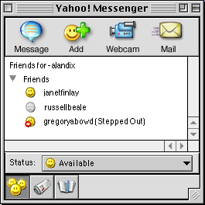
awareness
P
who is there
P
what is happening?
who is there
e.g. IM buddy list
what has happened
… and why?
what has
happened
how did
it happen
A

Slide 51
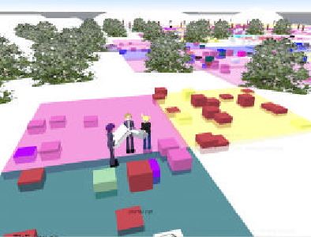
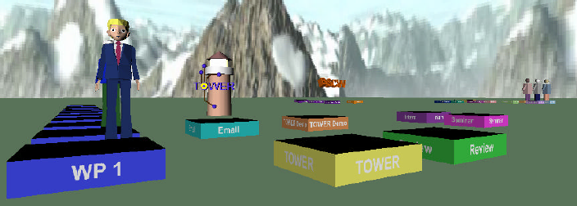

TOWER – workspace awareness
virtual ‘space’
  work objects (files etc.) shown as buildings
  avatars where other people are working
  built over flexible event infrastructure
see http://tower.gmd.de/

Slide 52
implementing groupware
feedback and network delays
architectures for groupware
feedthrough and network traffic
toolkits, robustness and scaling

Slide 53


Feedback and network delays
screen
feedback
local
machine
remote
machine
remote
application
network
9
8
7
6
5
2
3
4
1
user types
client
server
At least 2 network messages + four context switches
With protocols 4 or more network messages

Slide 54
Types of architecture
centralised – single copy of application and data
  client-server – simplest case
    N.B. opposite of X windows client/server
  master-slave special case of client-server
    N.B. server merged with one client
replicated – copy on each workstation
  also called peer-peer
  + local feedback
  race conditions
Often ‘half way’ architectures:
  local copy of application + central database
  local cache of data for feedback
  some hidden locking

Slide 55
Client-server architecture
user 1
user 2
… …
user n
client 1
client 2
client n
… …
server

Slide 56
Shared window architecture
Non-collaboration aware applications
⇒ client/server approach
corresponding feedback problems
no ‘functionality’ – in the groupware
but must handle floor control
example: shared X
  single copy of real application
  user stub for each user acts as an X application (X client)
  one application stub acts like X server for real application
  user stub passes events to single application stub
  stubs merge X events coming in
  and replicate X lib calls going out (strictly protocol)

Slide 57
Shared X
user 1
user 2
… …
user n
X
X
… …
X
user
X events
X lib
user
stub 1
user
stub 2
… …
user
stub n
X
X events
X lib
application
stub
application
X events
X lib
application

Slide 58
Feedthrough & traffic
Need to inform all other clients of changes
Few networks support broadcast messages, so …
n participants ⇒ n–1 network messages!
Solution: increase granularity
  reduce frequency of feedback
  but …
  poor feedthrough ⇒ loss of shared context
Trade-off: timeliness vs. network traffic

Slide 59
Graphical toolkits
Designed for single user interaction
Problems for groupware include
  pre-emptive widgets
  (e.g., pop-up menus)
  over-packaged text
  (single cursor, poor view control)
notification-based toolkits with callbacks help (chap. 8)

Slide 60
Robustness and scaleability
crash in single-user interface – one sad user
crash in groupware – disaster !
but …
  groupware complex: networks, graphics etc.
  scaling up to large numbers of users?
  testing and debugging – hard!

Slide 61
… some tips …
network or server fails – standard solutions
client fails – three `R's for server:
  robust – server should survive client crash
  reconfigure – detect and respond to failure
  resynchronise – catch up when client restarts
errors in programming
  defensive programming
  simple algorithms
  formal methods
unforeseen sequences of events
  deadlock – never use blocking I/O
  never assume particular orders
  network packet ≠ logical message

Slide 62
scaling and testing
scaling up
  robustness ⇒ simple algorithms
  … but don’t scale well – need to evolve
  good software architecture helps
  document fixed-size assumptions
  know operating system limits (e.g. open files)
testing for robustness
  take off the kid gloves … mistreat it
  reboot, pull out network cable, random input
  create a rogue client, simulate high loads
  and when you think it is perfect
  … give it to some computing students to test

